Slide 1
PROJECT REPORT ON “The Battle of Neighborhoods” (Analyzing Neighborhoods in Delhi) Submitted by: Reshabh Chauhan December 2019

Slide 2
INTRODUCTION
Problem: -
In this project, I am going to resolve my friend's problem, who wants to open a 'Badminton Academy' in Delhi, the National Capital of India. As I am a badminton player, therefore, He asked me about the place where He should open his badminton academy in Delhi so that He'll get lots of badminton players to learn in his academy.

Slide 3
METHODOLOGY Secondary Data: - This project is based on the secondary data which is collected from the internet using Wikipedia and Delhi Govt. websites. This Data includes ‘Geographical Data’ of Delhi, The National Capital of India which includes few Neighborhoods, their Postal Codes, Latitude, and Longitude.

Slide 4
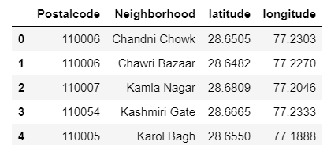
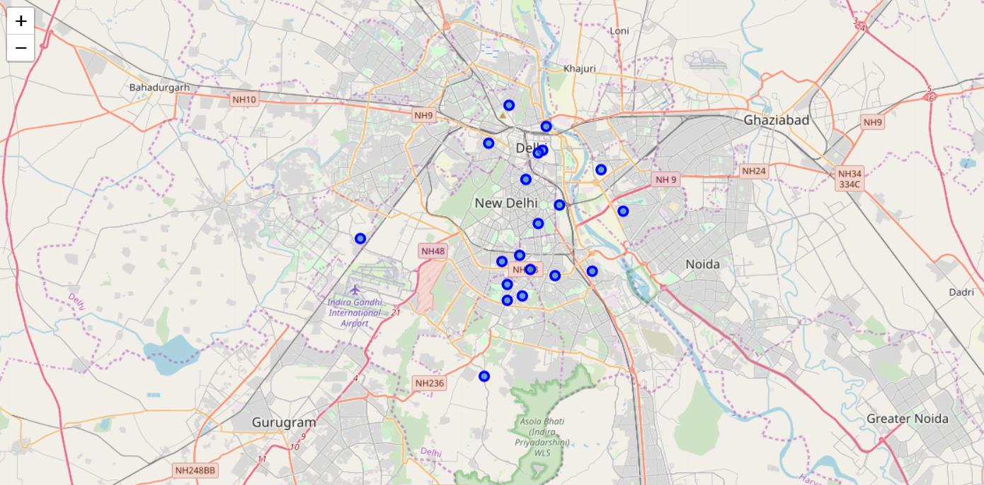
Data-frame and Map

Slide 5
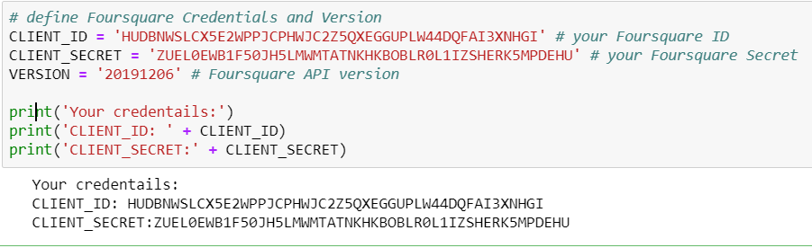
Foursquare Credentials:-

Slide 6
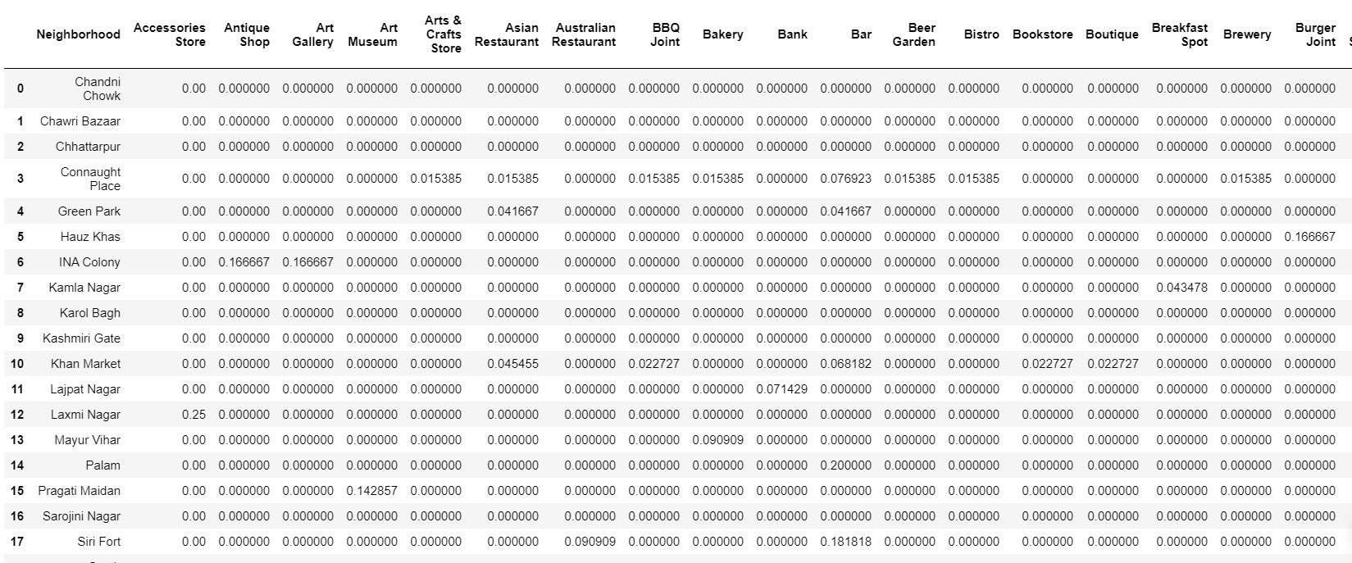
Analysis of each Neighborhood: -

Slide 7
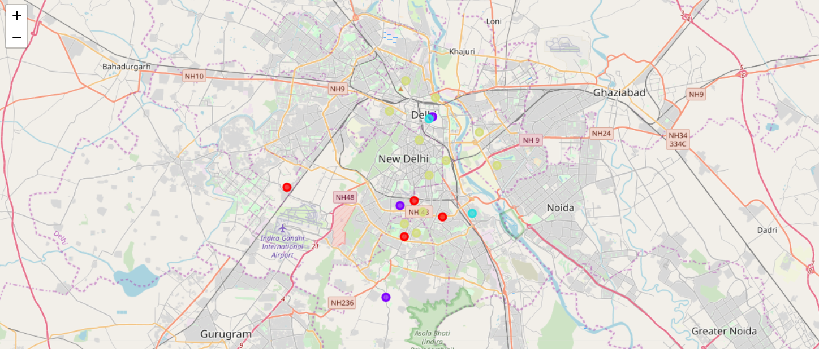
Data Clustering is used as Machine Learning Algorithm: -

Slide 8
FINDINGS From the above analysis of around 20 Neighborhoods in Delhi, we found that we have around 95 Venues. After analyzing those Venues, we have created 4 clusters of Neighborhoods that having the same Venues nearby. We found the venues using ‘Foursquare API’ and then cluster the Neighborhoods by analyzing those venues by their frequency or number of occurrences in those respective Neighborhoods.

Slide 9
FINDINGS(Cont.) We used Clustering Machine Learning Algorithm to analyze our project so that the Neighborhoods which are having almost the same venues, can be put together to make a cluster. All clusters have different types of venues or properties but the Neighborhoods in the same cluster will possess almost the same properties.

Slide 10
DISCUSSION AND SUGGESTIONS As I discussed above, in our analysis we have noted Neighborhoods’ nearby places are not suitable for open a badminton academy but those areas have good opportunities if we want to open water parks, bars, Shopping malls, BnB services, Salon, Gaming zones, etc.

Slide 11
CONCLUSION As the analyses, part shows that we have found a lot of venues nearby the Neighborhoods but we not able to get the venues which will actually suitable to start a badminton academy. Badminton academy required a suitable place, good connectivity, sports-loving people, and a healthy and polluted free environment. The venues we have found in our analysis are more like; Restaurants, Cafe, Beer Bars, Coffee Shops, etc. I think it will not be beneficial to start a badminton academy nearby those venues as we’ll not get as many players to join there.

